Slide 1
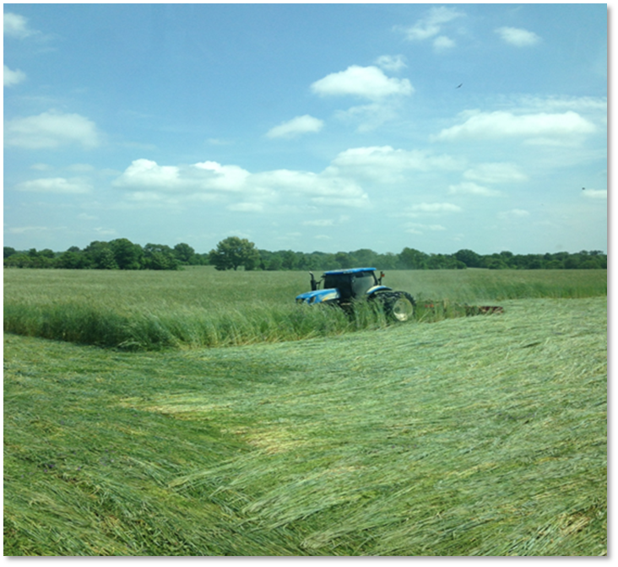
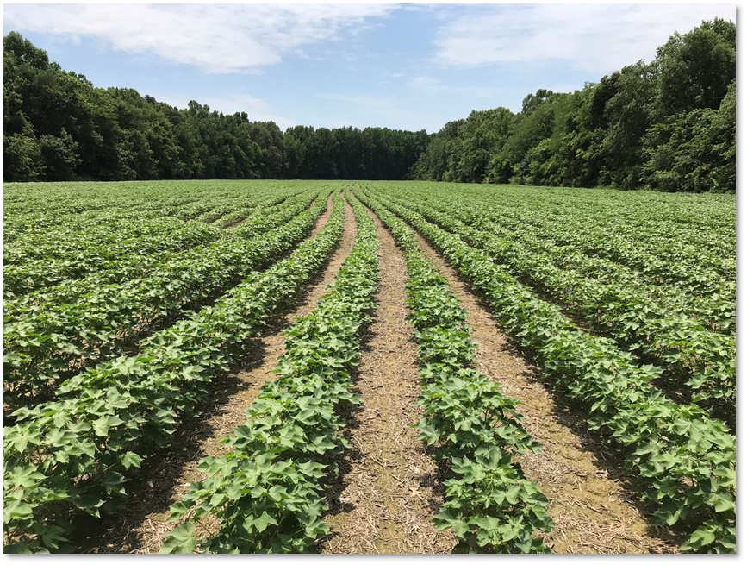


Presenter’s Name
Cover Crops in Regional Cropping Systems

Slide 2
Presentation Objectives
Describe the utilization and management of cover crops in regionally important cropping systems.
Compare and contrast case studies of cover cropping success in regional cropping systems.
Discuss challenges to incorporating cover crops in these cropping systems, as well as opportunities to address and overcome those challenges.
Notes:
The purpose of this module is to highlight the successful use of cover crops in cropping systems that are economically important in the region where the Advanced Cover Crop class is taking place. This module describes how cover crops are integrated into two or three regional cropping systems.
This slide deck will end with slides that can be used as prompts for the class discussion in this module.
Please refer to the last slide in the deck for recommendations on formatting of the slides

Slide 3
Case Studies
Cotton and Soybeans – SE Missouri
Corn and Soybean – SW & NE Missouri
Notes:
List systems that will be covered in this particular class. For example: 1. Corn/Soybean cropping system; 2. Cotton cropping system. Etc.
This presentation is allotted 45 min the class curriculum. That is enough time to cover 2 – 3 case studies in detail. Conservatively two case studies can be covered in good detail and with space for questions and discussion in 45 min.

Slide 4
Cotton in SE Missouri
Notes:
Change “First Case Study” to name of cropping system – ex. Corn/Soybean cropping system

Slide 5
Cotton – Crop Rotation and Annual Schedule
Crop Rotation
  Continuous Cotton
  Cotton/Soybean
Annual Schedule
  Cotton
    Planting: April 20 to June 1
    Harvest: Oct. 1 to Nov. 15
  Soybean (full season)
    Planting: April 15 to June
    Harvest: Sept 15 to Nov 30
Cover Crop Seasonal Niches
  Fall/winter/spring planting opportunities in this system
Photo: Matthew Denton, USDA NRCS
Notes:
Change “System 1” to name of cropping system
Include representative image or photo in content box on right side if possible.

Slide 6
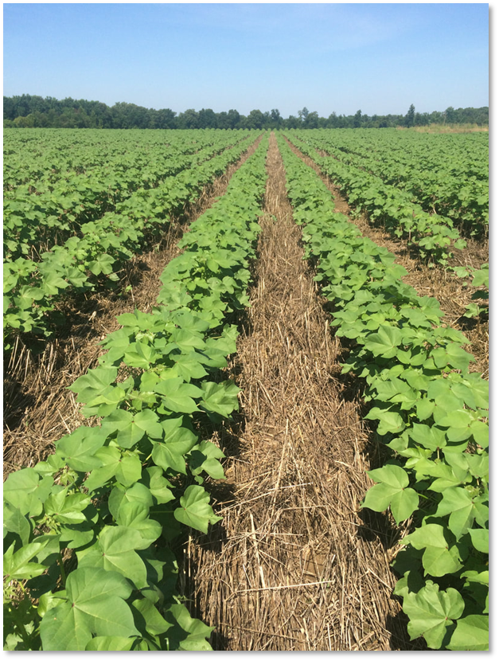
Cotton – Resource Concerns
Resource Concerns:
Aggregate stability
  Infiltration
Wind erosion
  Seedling protection – planting wheat or cereal rye in row middles common.
  Cereals at jointing protect seedlings from blowing sand and diseases aided from damaged cotyledons.
Pest management
  Weed suppression
Photo: Matthew Denton, USDA NRCS
Notes:
Change “System 1” to name of cropping system
Include representative image or photo in content box on right side if possible.
List and discuss resource concerns that are commonly addressed with cover crops in this system.
Also list and discuss specific management objectives that producers and planners are trying to achieve through the use of cover crops in this system.

Slide 7
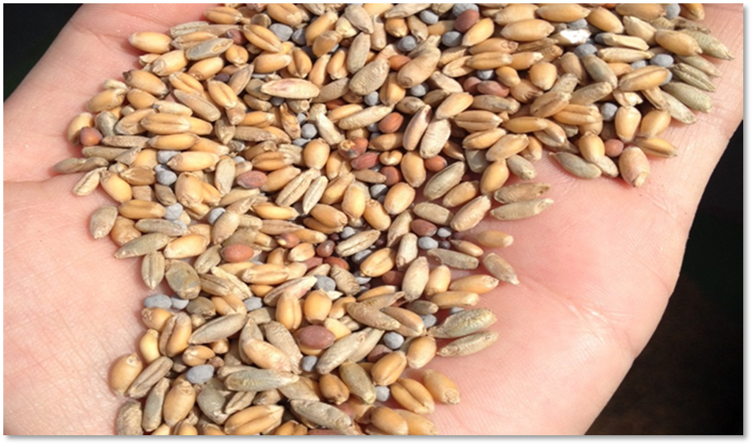
Cotton – Cover Crop Species and Mixes
Cover Crop Species
  Cereals – cereal rye, wheat, oats, annual ryegrass, triticale, barley
  Legumes – hairy vetch, crimson clover, red clover, balansa clover, winter peas
  Brassicas – radish, turnip, rape
Photo: Matthew Denton, USDA NRCS
Notes:
Change “System 1” to name of cropping system
Include representative image or photo in content box on right side if possible.

Slide 8
Cotton – CC Planting and Termination
Planting times
  Following cotton – Oct 1 to Dec 1
  Following soybean – October 15 thru December 1
Termination times
  Prior to cotton – 2-3 weeks prior to planting. Occasional plant green.
  Prior to soybean – plant green is common.
Photo: Matthew Denton, USDA NRCS
Notes:
Change “System 1” to name of cropping system
Include representative image or photo in content box on right side if possible.

Slide 9
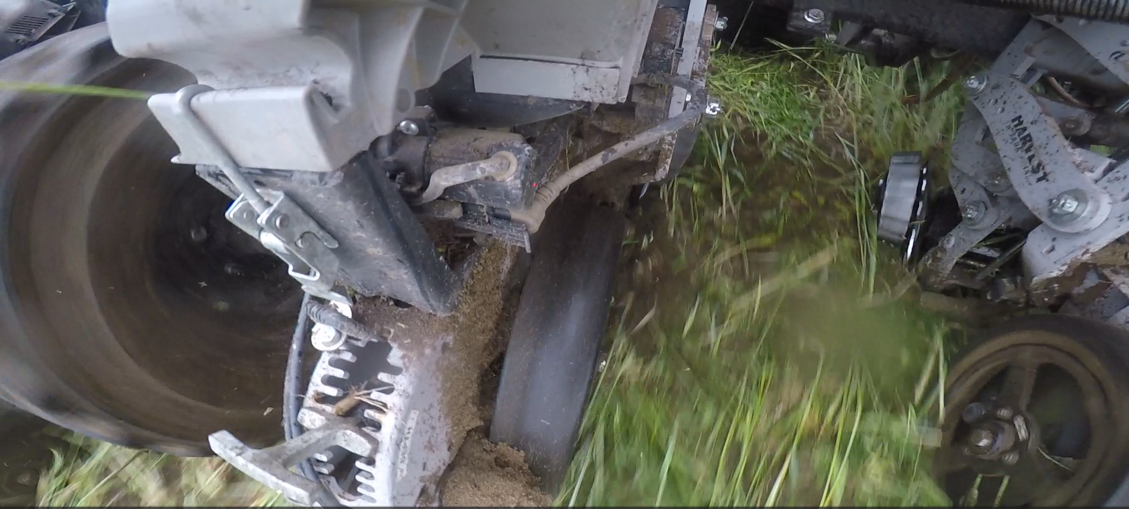
Cotton - Equipment
Equipment
Planter
  Often remove attachments – i.e. row cleaners.
  Replace packing wheels.
Furrow irrigated fields
  Often use a ‘torpedo furrow opener’ to clear furrow of residue.
  Sometimes used to compact furrow to aide water flow.
  Some utilize tool bar with single shank on each irrigation furrow (every other furrow) to do the same.
Photo: Drexel Atkisson, USDA NRCS
Notes:
Change “System 1” to name of cropping system
Include representative image or photo in content box on right side if possible.
Describe the use of equipment in planting and termination of cover crop. Focus on any aspects of equipment management that are unique or key to success of this particular cropping system.

Slide 10
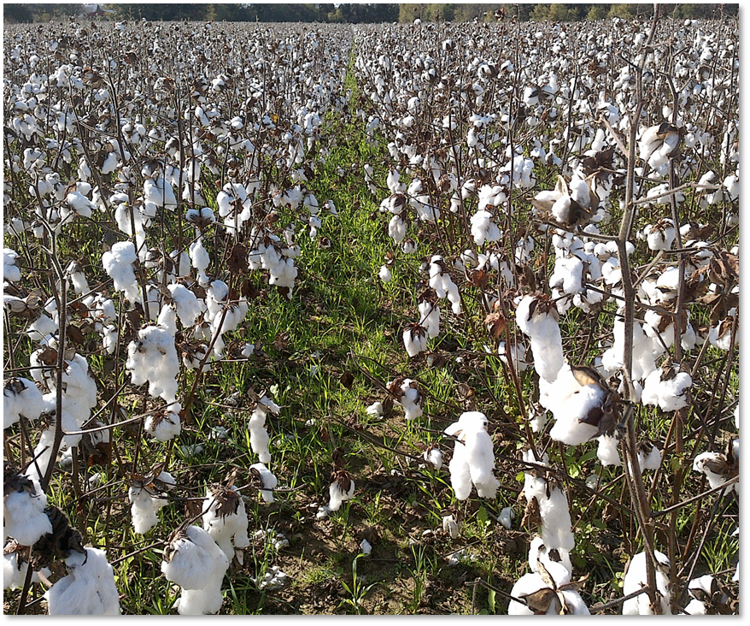
Cotton – Cover Crop Challenges
Common Challenges with Cover Cropping
  Late harvest dates leading to late cover crop seeding
  Early season termination prior to cotton planting losing benefits of spring CC growth
  Labor/time
Photo: Matthew Denton, USDA NRCS
Notes:
Change “System 1” to name of cropping system
Include representative image or photo in content box on right side if possible.
Discuss challenges to incorporating cover crops in this cropping system. What challenges to producers commonly describe? What are the reasons that some producers in this system may be reluctant to incorporate cover cropping?

Slide 11
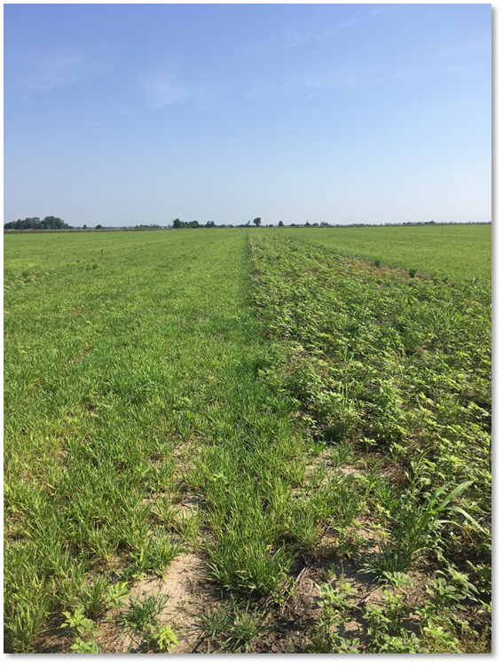
Cotton – CC Opportunities
Opportunities to Enhance CCs
Promote weed suppression of problem weeds
  Palmer Pigweed a major opportunity.
Providing a successful way to broadcast seed mixes into soybean would be beneficial.
  Currently it is very weather dependent.
Bootheel is heavily tilled. Notill is gaining but still a low percentage.
  Cover crops will aid transition to notill making it ‘doable’
  Prime land owned/farmed by larger operations or cotton gins are often planted continuously to cotton.
  CC mixes provide an excellent opportunity to increase diversity.
Photo: Drexel Atkisson, USDA NRCS
Notes:
Change “System 1” to name of cropping system
Include representative image or photo in content box on right side if possible.
Discuss the potential opportunities to enhance/improve cover crop management in this system to improve soil health.
Are there additional cover crop species or mixes that could be considered for this system?
Are innovative producers currently managing cover crops with additional complexity in the system to improve soil health?
Is there opportunity to incorporate grazing of cover crops?

Slide 12
Questions/Comments on Cotton Case Study?
Notes:
Provide an opportunity to address a few questions or comments related to the material presented in case study one.
Be mindful of the overall time allotted for the presentation and check the status of time at this point.
Do not devote much time to discussion at this point if you are behind on time in the presentation.

Slide 13
Corn & Soybean Rotation – SW and NE Missouri
Notes:
Change “Second Case Study” to name of cropping system – ex. Corn/Soybean cropping system

Slide 14
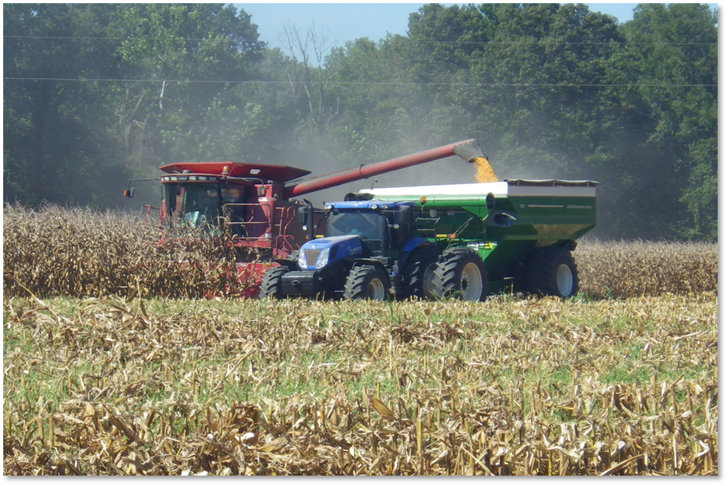
Corn/Soy – Crop Rotation and Annual Schedule
Crop Rotation
  Corn and Soybeans in alternating years
Annual Schedule
  Corn
    Plant: March 1 – May 15
    Harvest: Aug. 15 – Oct. 15
  Soybean
    Plant: June 1 – June 10
    Harvest: Oct. 15 – Nov 15
Photo: Matthew Denton, USDA NRCS
Notes:
Change “System 2” to name of cropping system
Include representative image or photo in content box on right side if possible.

Slide 15
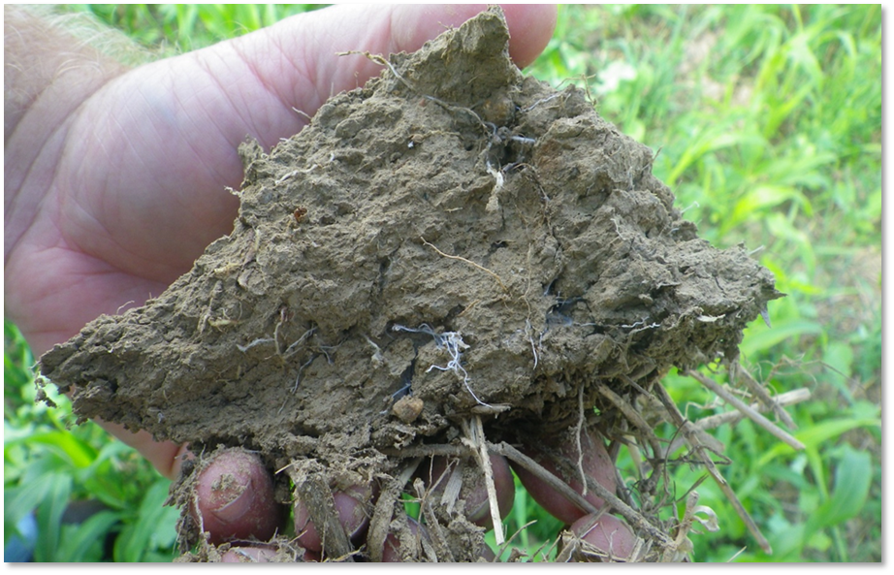
Corn/Soy – Resource Concerns
Resource Concerns:
  Erosion prevention, primarily on HEL
  Organic matter depletion
  Aggregate stability -> improved infiltration
Specific Management Objectives
  Incidental forage for stockers or cows for some producers
Photo: Matthew Denton, USDA NRCS
Notes:
Change “System 2” to name of cropping system
Include representative image or photo in content box on right side if possible.
List and discuss resource concerns that are commonly addressed with cover crops in this system.
Also list and discuss specific management objectives that producers and planners are trying to achieve through the use of cover crops in this system.

Slide 16
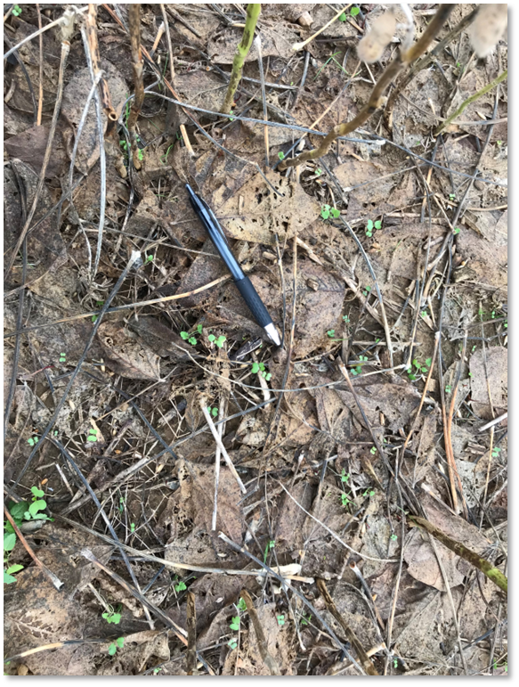
Corn/Soy – Seasonal Niches for Cover Crops
Cover Crop Seasonal Niches
  Following corn harvest:
    Generally, a good early opportunity to plant a diverse cover crop mix.
    Can be drilled following harvest or may be flown on if wanting done earlier.
  Following soybeans
    More challenging with harvest being late.
    If completed after harvest, limited to 1 or 2 cereal grains.
    If broadcast just prior to leaf drop, then diverse mixes can be used.
Photo: Matthew Denton, USDA NRCS
Notes:
Change “System 1” to name of cropping system
Include representative image or photo in content box on right side if possible.
Describe the seasonal niches when cover crops are typically grown in the system

Slide 17
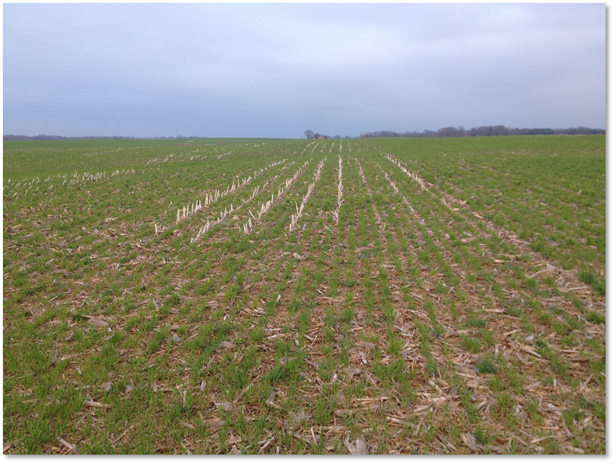
Corn/Soy – Cover Crop Species
Cover Crop Species
SW Missouri
  1 to 3 species – occasionally up to 5-8 species.
  Cereals – cereal rye, wheat, oats, annual ryegrass, triticale, barley
  Legumes – hairy vetch, crimson clover, red clover, balansa clover, winter peas
  Brassicas – radish, turnip, rape
NE Missouri
  Cool-season grasses are very common, easy to plant and do well in the environment
  Typically rye, wheat or triticale
Photo: Matthew Denton, USDA NRCS
Notes:
Change “System 2” to name of cropping system
Include representative image or photo in content box on right side if possible.

Slide 18
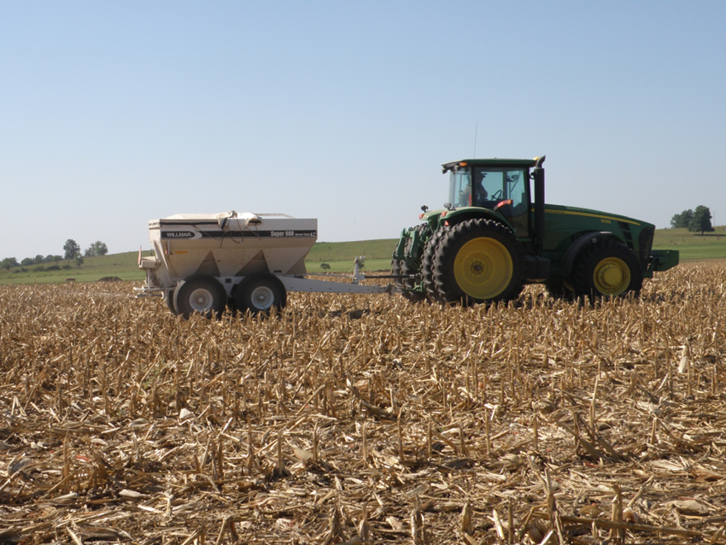
Corn/Soy – CC Planting and Termination
Planting times
SW Missouri
  Following corn - Sep 15 to November
  Following soybean – October 15 thru December 1
  when additional forage is a producer goal, then mixes are broadcast as above prior to leaf drop. (September)
NE Missouri
  mid-Sept to early-November depending on corn harvest
Photo: Drexel Atkisson, USDA NRCS
Notes:
Change “System 2” to name of cropping system
Include representative image or photo in content box on right side if possible

Slide 19
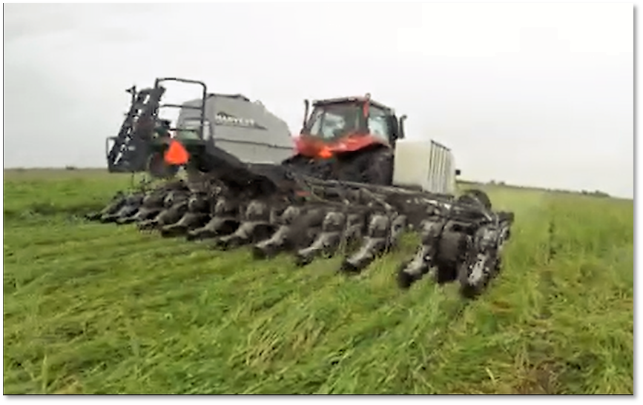
Corn/Soy – CC Planting and Termination
Termination times
SW Missouri
  Prior to corn – 2-3 weeks prior to planting. Occasional plant green.
  Prior to soybean (sans wheat) – occasional plant green.
    Soil moisture is concern
NE Missouri
  Just prior to planting SB’s or 5-20 days after planting, depending on equipment that is available.
Photo: Drexel Atkisson, USDA NRCS
Notes:
Change “System 2” to name of cropping system
Include representative image or photo in content box on right side if possible.

Slide 20
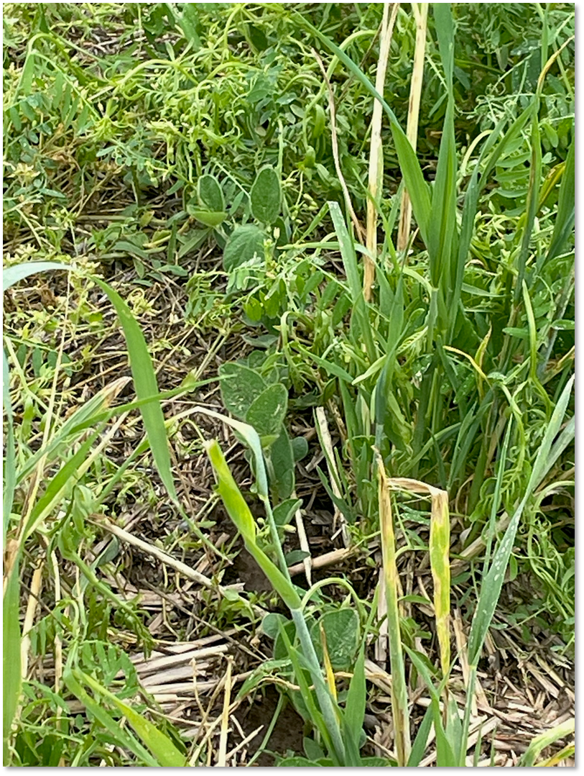
Photo: Drexel Atkisson, USDA NRCS

Slide 21
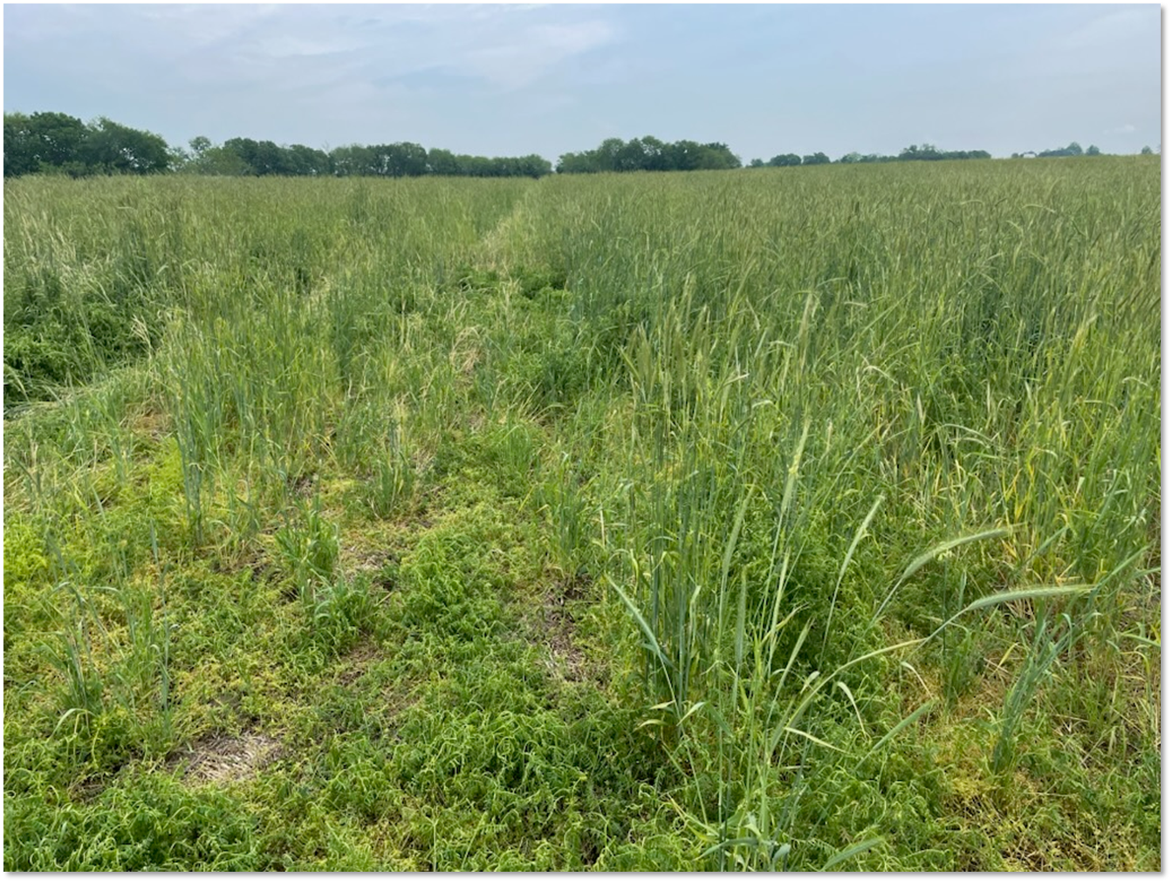
Photo: Drexel Atkisson, USDA NRCS

Slide 22
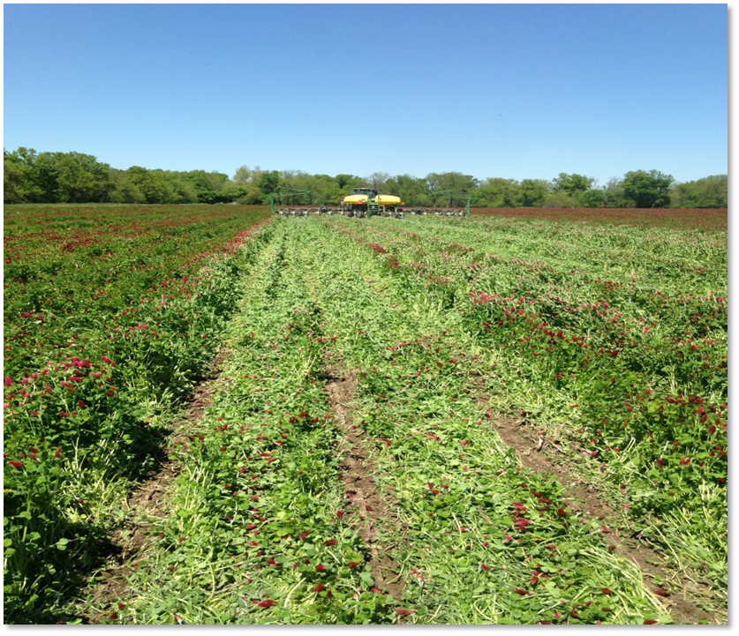
Corn/Soy - Equipment
Required Equipment
SW Missouri
  Often remove planter attachments – i.e. row cleaners. Replace packing wheels.
  Some type of high ride drill or broadcaster.
    Drone, airplane, high tool bar specialized drill, high ride air seeder.
NE Missouri
  planted with a drill or broadcast w/light incorporation,
  some have put seeders on combine heads
Photo: Drexel Atkisson, USDA NRCS
Notes:
Change “System 1” to name of cropping system
Include representative image or photo in content box on right side if possible.
Describe the use of equipment in planting and termination of cover crop. Focus on any aspects of equipment management that are unique or key to success of this particular cropping system.

Slide 23
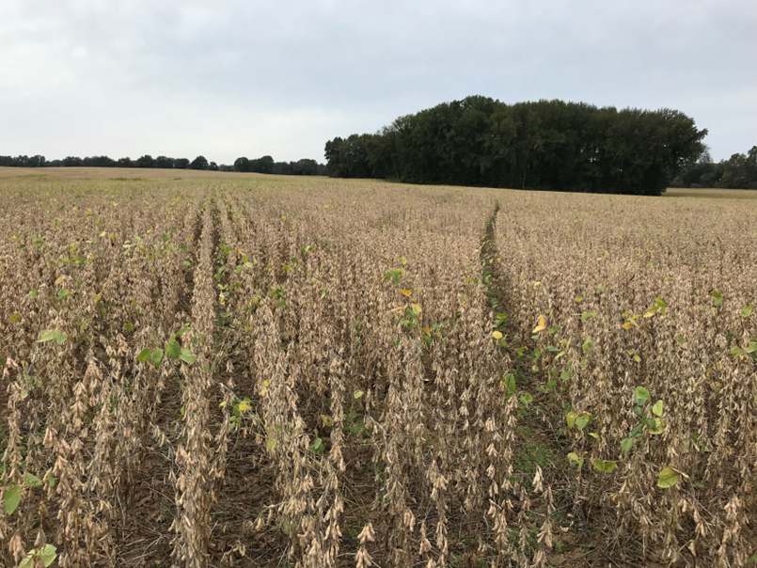
Corn/Soy – CC Challenges
Common Challenges
SW Missouri
  Nitrogen management prior to corn
  Late soybean harvest date leading to late cover crop seeding
  Early season termination prior to corn planting losing benefits of spring CC growth
  Labor, time and equipment expense for smaller operations
  Managing the livestock when field conditions become unfriendly to livestock. (too wet and muddy, too hot with no shade)
Photo: Matthew Denton, USDA NRCS
Notes:
Change “System 2” to name of cropping system
Include representative image or photo in content box on right side if possible.
Discuss challenges to incorporating cover crops in this cropping system. What challenges to producers commonly describe? What are the reasons that some producers in this system may be reluctant to incorporate cover cropping?

Slide 24
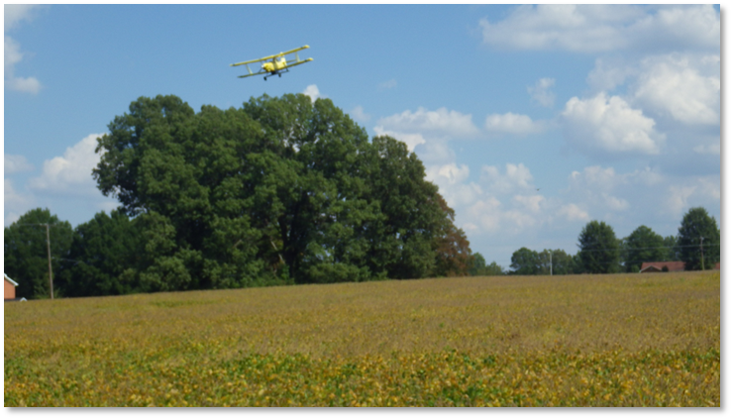
Corn/Soy – CC Challenges
Common Challenges
NE Missouri
  Getting the CC in early enough to get good growth before frost,
  Planting into green cover may be a challenge to the producer if they are not used to that or if their planter is not setup properly.
  Trying to get it planted early enough to have it grow and be able to graze it prior to the winter.
Photo: Matthew Denton, USDA NRCS
Notes:
Change “System 2” to name of cropping system
Include representative image or photo in content box on right side if possible.
Discuss challenges to incorporating cover crops in this cropping system. What challenges to producers commonly describe? What are the reasons that some producers in this system may be reluctant to incorporate cover cropping?

Slide 25
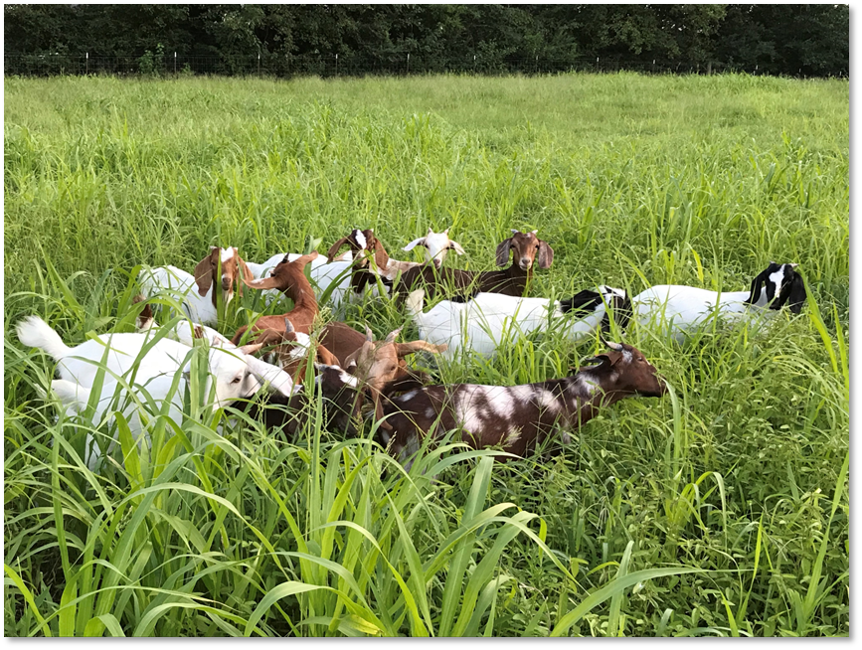
Corn/Soy – CC Opportunities
Opportunities to Enhance CCs
SW Missouri
  In northern parts of region, producer may follow wheat with a summer mix to build nitrogen prior to corn.
    Lose soybean crop.
  HEL ground especially opportunities to bring in livestock. Infrastructure a major obstacle.
  Promote weed suppression of problem weeds – such as Palmer Pigweed.
  Incorporate more species into the mixes,
    Continued fear of many species like annual rye grass and hairy vetch.
    Having more knowledge of such species and their contributions to SHMS is very important.
Photo: Matthew Denton, USDA NRCS
Notes:
Change “System 2” to name of cropping system
Include representative image or photo in content box on right side if possible.
Discuss the potential opportunities to enhance/improve cover crop management in this system to improve soil health.
Are there additional cover crop species or mixes that could be considered for this system?
Are innovative producers currently managing cover crops with additional complexity in the system to improve soil health?
Is there opportunity to incorporate grazing of cover crops?

Slide 26
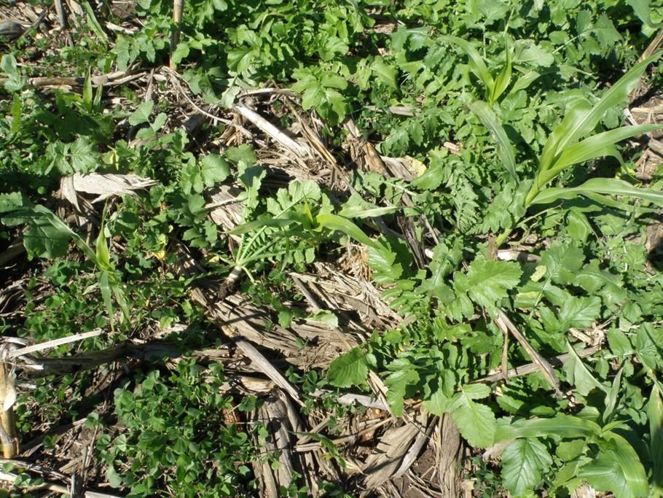
Corn/Soy – CC Opportunities
Opportunities to Enhance CCs
NE Missouri
  Expand rotation to include CC after SBs in front of corn. But requires a new level of management.
    Beans need earlier harvest date
    Potential inter-seeding
  More CCs could be used in the mix if corn is removed early in September.
  Wheat could be added to the rotation to allow for more living roots through the year
Photo: Drexel Atkisson, USDA NRCS
Notes:
Change “System 2” to name of cropping system
Include representative image or photo in content box on right side if possible.
Discuss the potential opportunities to enhance/improve cover crop management in this system to improve soil health.
Are there additional cover crop species or mixes that could be considered for this system?
Are innovative producers currently managing cover crops with additional complexity in the system to improve soil health?
Is there opportunity to incorporate grazing of cover crops?

Slide 27
Questions/Comments on
Corn/Soy Case Study ??
Notes:
Provide an opportunity to address a few questions or comments related to the material presented in case study one.
Be mindful of the overall time allotted for the presentation and check the status of time at this point.
Do not devote much time to discussion at this point if you are behind on time in the presentation.

Slide 28
Class Discussion
What challenges to incorporating cover crops have you encountered while working with producers in your home region?
What lessons have you learned from successful cover cropping projects and producers in your home region?
Discuss in small groups for 7-8 minutes and identify one group member who will report back to class on discussion. Discuss cropping systems that you work with in your home region. Does not need to be the systems presented here.
Notes:
Ask class participants to discuss the following prompts with a group of 3-4 students that are sitting around them. They should discuss these questions in the context of cropping systems that they work in as conservation planners in their home region.
Provide printed handout that includes discussion questions and space for participants to make notes.
Groups should designate one person who will report back on discussion to larger class. Students will need to identify the type of cropping systems that they discussed in their group.
Allow 7-8 minutes for discussion in small groups and approx. 10 minutes for reporting back.

Slide 29
Thank you!
For more information on Managing Soil Health,
visit us here:
https://www.nrcs.usda.gov/conservation-basics/natural-resource-concerns/soils/soil-health
USDA is an equal opportunity provider, employer, and lender.

